Slide 1
Играта ☺

Slide 2
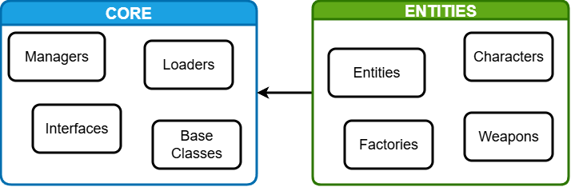
Модули

Slide 3
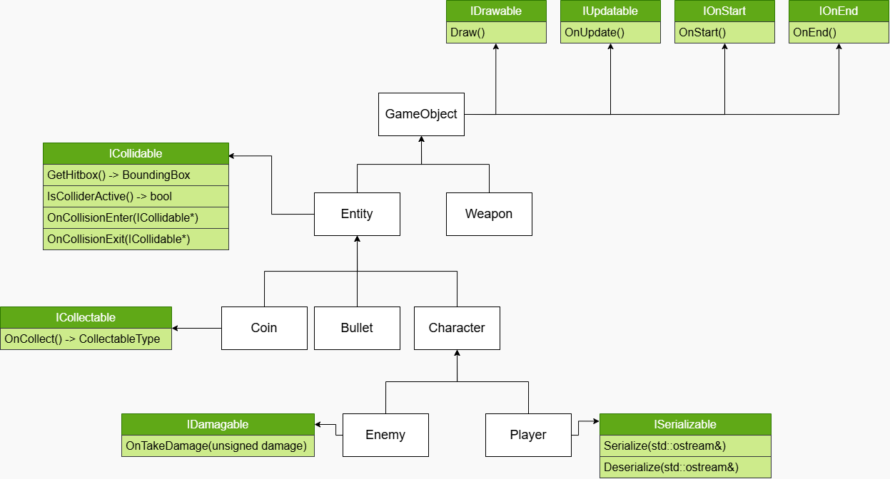

Slide 4
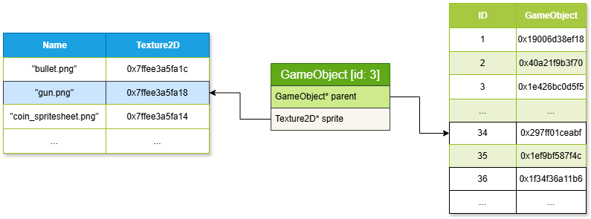

Slide 5
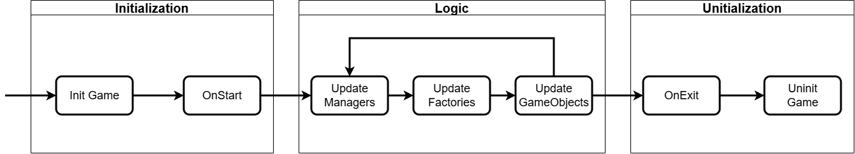
Game workflow

Slide 6
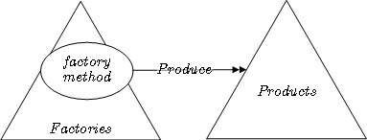
Factory pattern

Slide 7
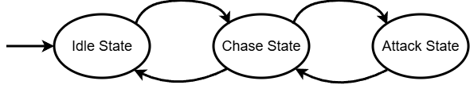
Enemy state machine

Slide 8
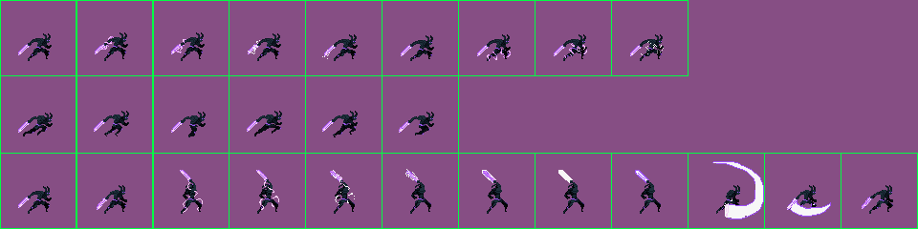
Enemy animation
Layer 0 (idle):
Layer 1 (chase):
Layer 2 (attack):

